Slide 1
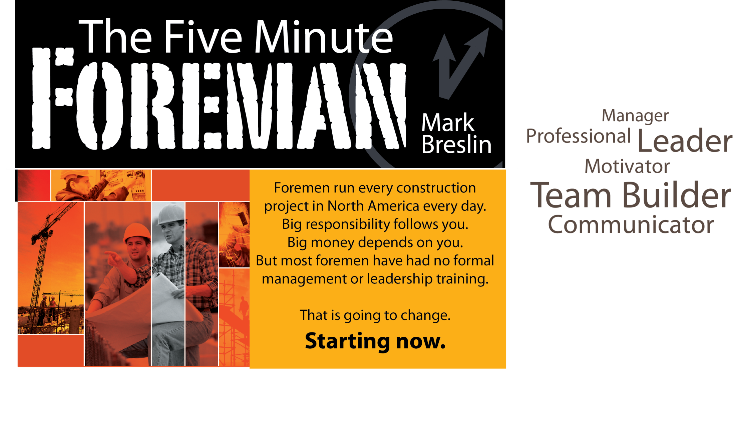

PERSONAL ACTION
PLAN

Slide 2
Table of Contents
CHAPTER 1: The Ten Faces of the Fearless Foreman
CHAPTER 2: Professionalism, Safety, Integrity, and Quality
CHAPTER 3: Effective Communication for Loyalty and Results
CHAPTER 4: Improving Motivation and Performance
CHAPTER 5: Teaching, Coaching, and Discipline for Accountability
CHAPTER 6: Goal Setting for Production and Profit
CHAPTER 7: Building Teams and Relationships
CHAPTER 8: Mentoring and Knowledge Transfer
THE FIVE MINUTE FOREMAN – Wrap Up

Slide 3
CHAPTER ONE:
The Ten Faces of the Fearless Foreman

Slide 4
Question 1
What is the purpose of a professional construction leader?
CHAPTER: 1

Slide 5
Question 2
What two significant things are more important than the work and the money?
CHAPTER: 1

Slide 6
Question 3
What is perhaps the most important part of being a construction leader?
CHAPTER: 1

Slide 7
Question 4
When you compromise safety, what do you also compromise?
CHAPTER: 1

Slide 8
Question 5
What is the estimated dollar volume you will manage in a thirty year career?
Annual Volume Managed: $ ______ x 30 years = $______
Does this number surprise you?
Why/Why Not?
CHAPTER: 1

Slide 9
Question 6
Do you assume most foreman have received professional management or leadership training?
CHAPTER: 1

Slide 10
Question 7
List some obvious skills you have to develop to succeed as a foreman:
CHAPTER: 1

Slide 11
Question 8
Identify top areas that your crew and the contractor rely on you for:
CHAPTER: 1

Slide 12
Question 9
What are the “values blueprints” that can assist you in building your career and relationships?
CHAPTER: 1

Slide 13
Question 10
How would you identify the ultimate foundation of a professional foreman?
CHAPTER: 1

Slide 14
Question 11
What is one of the most influential and visible ways employees on the jobsite learn?
CHAPTER: 1

Slide 15
CHAPTER TWO:
Professionalism, Safety, Integrity and Quality

Slide 16
Question 1
List some mandatory core competencies for a top foreman:
CHAPTER: 2

Slide 17
Question 2
What is one of the first steps you should take in creating your foundation of being a Professional Construction Leader?
CHAPTER: 2

Slide 18
Question 3
What two career paths have the ability to represent who you are as a foreman?
CHAPTER: 2

Slide 19
Question 4
List some steps you can take in order to change your thought process from blue-collar to a true Professional Construction Leader:
CHAPTER: 2

Slide 20
Question 5
For your own reference: What does a successful foreman resemble?
CHAPTER: 2

Slide 21
Question 6
Identify some areas that may change when you begin presenting yourself as a leader:
CHAPTER: 2

Slide 22
Question 7
What is one of the most expensive unanticipated costs associated with almost any construction project?
CHAPTER: 2

Slide 23
Question 8
What is one of the biggest stress factors a foreman is faced with when completing a job?
CHAPTER: 2

Slide 24
Question 9
Who does the ultimate liability of a bad construction project fall on?
Owner
Contractor
Subcontractor
Workers
CHAPTER: 2

Slide 25
Question 10
What is one of the most important and significant relationships you will have during a project?
CHAPTER: 2

Slide 26
Question 11
Where does positive change come from if not by leaning on traditions and legacy?
CHAPTER: 2

Slide 27
Question 12
List some areas where innovation on a job may be improved:
CHAPTER: 2

Slide 28
Question 13
List some tools that can help you survive on the job when it comes to documentation:
CHAPTER: 2

Slide 29
CHAPTER THREE:
Effective Communication for Loyalty and Results

Slide 30
Question 1
Write down one of the most effective ways to interact with your crew:
CHAPTER: 3

Slide 31
Question 2
Think of one thing that can dictate performance:
CHAPTER: 3

Slide 32
Question 3
What are the additional blueprints for providing clear direction?
CHAPTER: 3

Slide 33
Question 4
What is one critical tool you should have in your communications toolbox?
CHAPTER: 3

Slide 34
Question 5
What steps should you take to accept responsibility when you are wrong?
CHAPTER: 3

Slide 35
Question 6
What is the one largest payoff you will receive from a foreman?
CHAPTER: 3

Slide 36
CHAPTER FOUR:
Improving Motivation & Performance

Slide 37
Question 1
List the top three reasons for employee underachievement:
CHAPTER: 4

Slide 38
Question 2
What are the top motivators used in the workplace?
CHAPTER: 4

Slide 39
Question 3
List some tips on how to motivate your crew:
CHAPTER: 4

Slide 40
Question 4
In order to get your crew to perform at a higher level and own the outcome there is something you much share regularly?
CHAPTER: 4

Slide 41
Question 5
How do you give your employees the ability to act in a proactive way without getting their heads chopped off by you, the boss?
CHAPTER: 4

Slide 42
CHAPTER FIVE:
Teaching, Coaching & Discipline for Accountability

Slide 43
Question 1
Identify a stepping stone that can be used to improve performance:
CHAPTER: 5

Slide 44
Question 2
Whose responsibility is it to provide warnings to your crew?
CHAPTER: 5

Slide 45
Question 3
Identify examples of how your own failures can make you a better leader:
CHAPTER: 5

Slide 46
Question 4
What is one thing you should do when you are faced with a decision that you want to delay?
CHAPTER: 5

Slide 47
CHAPTER SIX:
Goal Setting for Production & Profit

Slide 48
Question 1
Do you set realistic goals and communicate them effectively to your crew?
Yes, Why?
No, Why Not?
CHAPTER: 6

Slide 49
Question 2
What two basic leadership concepts impact an individual’s performance?
CHAPTER: 6

Slide 50
Question 3
What key elements should you keep in mind when creating goals for your crew?
CHAPTER: 6

Slide 51
Question 4
What goal-setting mechanics should you keep in mind when setting goals?
CHAPTER: 6

Slide 52
Question 5
What is the easiest way to kill motivation?
CHAPTER: 6

Slide 53
Question 6
List some production goals for your crew that might improve performance:
CHAPTER: 6

Slide 54
CHAPTER SEVEN:
Building Teams & Relationship

Slide 55
Question 1
Your job as a leader is to create an ___________ that fosters cooperation, connection, and support.
CHAPTER: 7

Slide 56
Question 2
List qualities that a trustworthy team leader should have:
CHAPTER: 7

Slide 57
Question 3
List some qualities your winning team needs to develop:
CHAPTER: 7

Slide 58
Question 4
What specific skill must you possess in order to deal with conflict on your crew?
CHAPTER: 7

Slide 59
Question 5
How can promoting positive change affect your crew?
CHAPTER: 7

Slide 60
CHAPTER EIGHT:
Mentoring & Knowledge Transfer

Slide 61
Question 1
What one role, as a foreman, has the ability to impact most of our personal and professional lives?
CHAPTER: 8

Slide 62
Question 2
Why is mentoring at risk in our industry, and who does it affect?
CHAPTER: 8

Slide 63
Question 3
List some of the benefits you can receive from a mentor:
CHAPTER: 8

Slide 64
Question 4
What is one of the last contributions a leader provides to his team, organization, and industry?
CHAPTER: 8

Slide 65
Question 5
What has been identified as the tradition of passing down information from those with the most experience to those on their way up?
CHAPTER: 8

Slide 66
WRAP UP

Slide 67
THE FIVE MINUTE FOREMAN - Wrap Up
After reading The Five Minute Foreman – what are some of the changes you will be making in your career and with your crew?
CHAPTER: 8

Slide 68
Thank You!

